Slide 1

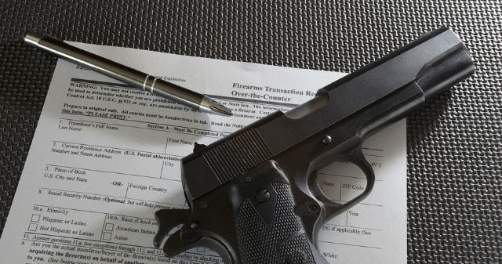
Gun Background Check
Kouamé Kouassi

Slide 2

Project Overview
DiagramFile
Sources
ETL process
PostgreSQL
Flask app
JS Libraries
HTML & CSS#
Website Navigation
This Photo by Unknown Author is licensed under CC BY-SA

Slide 3

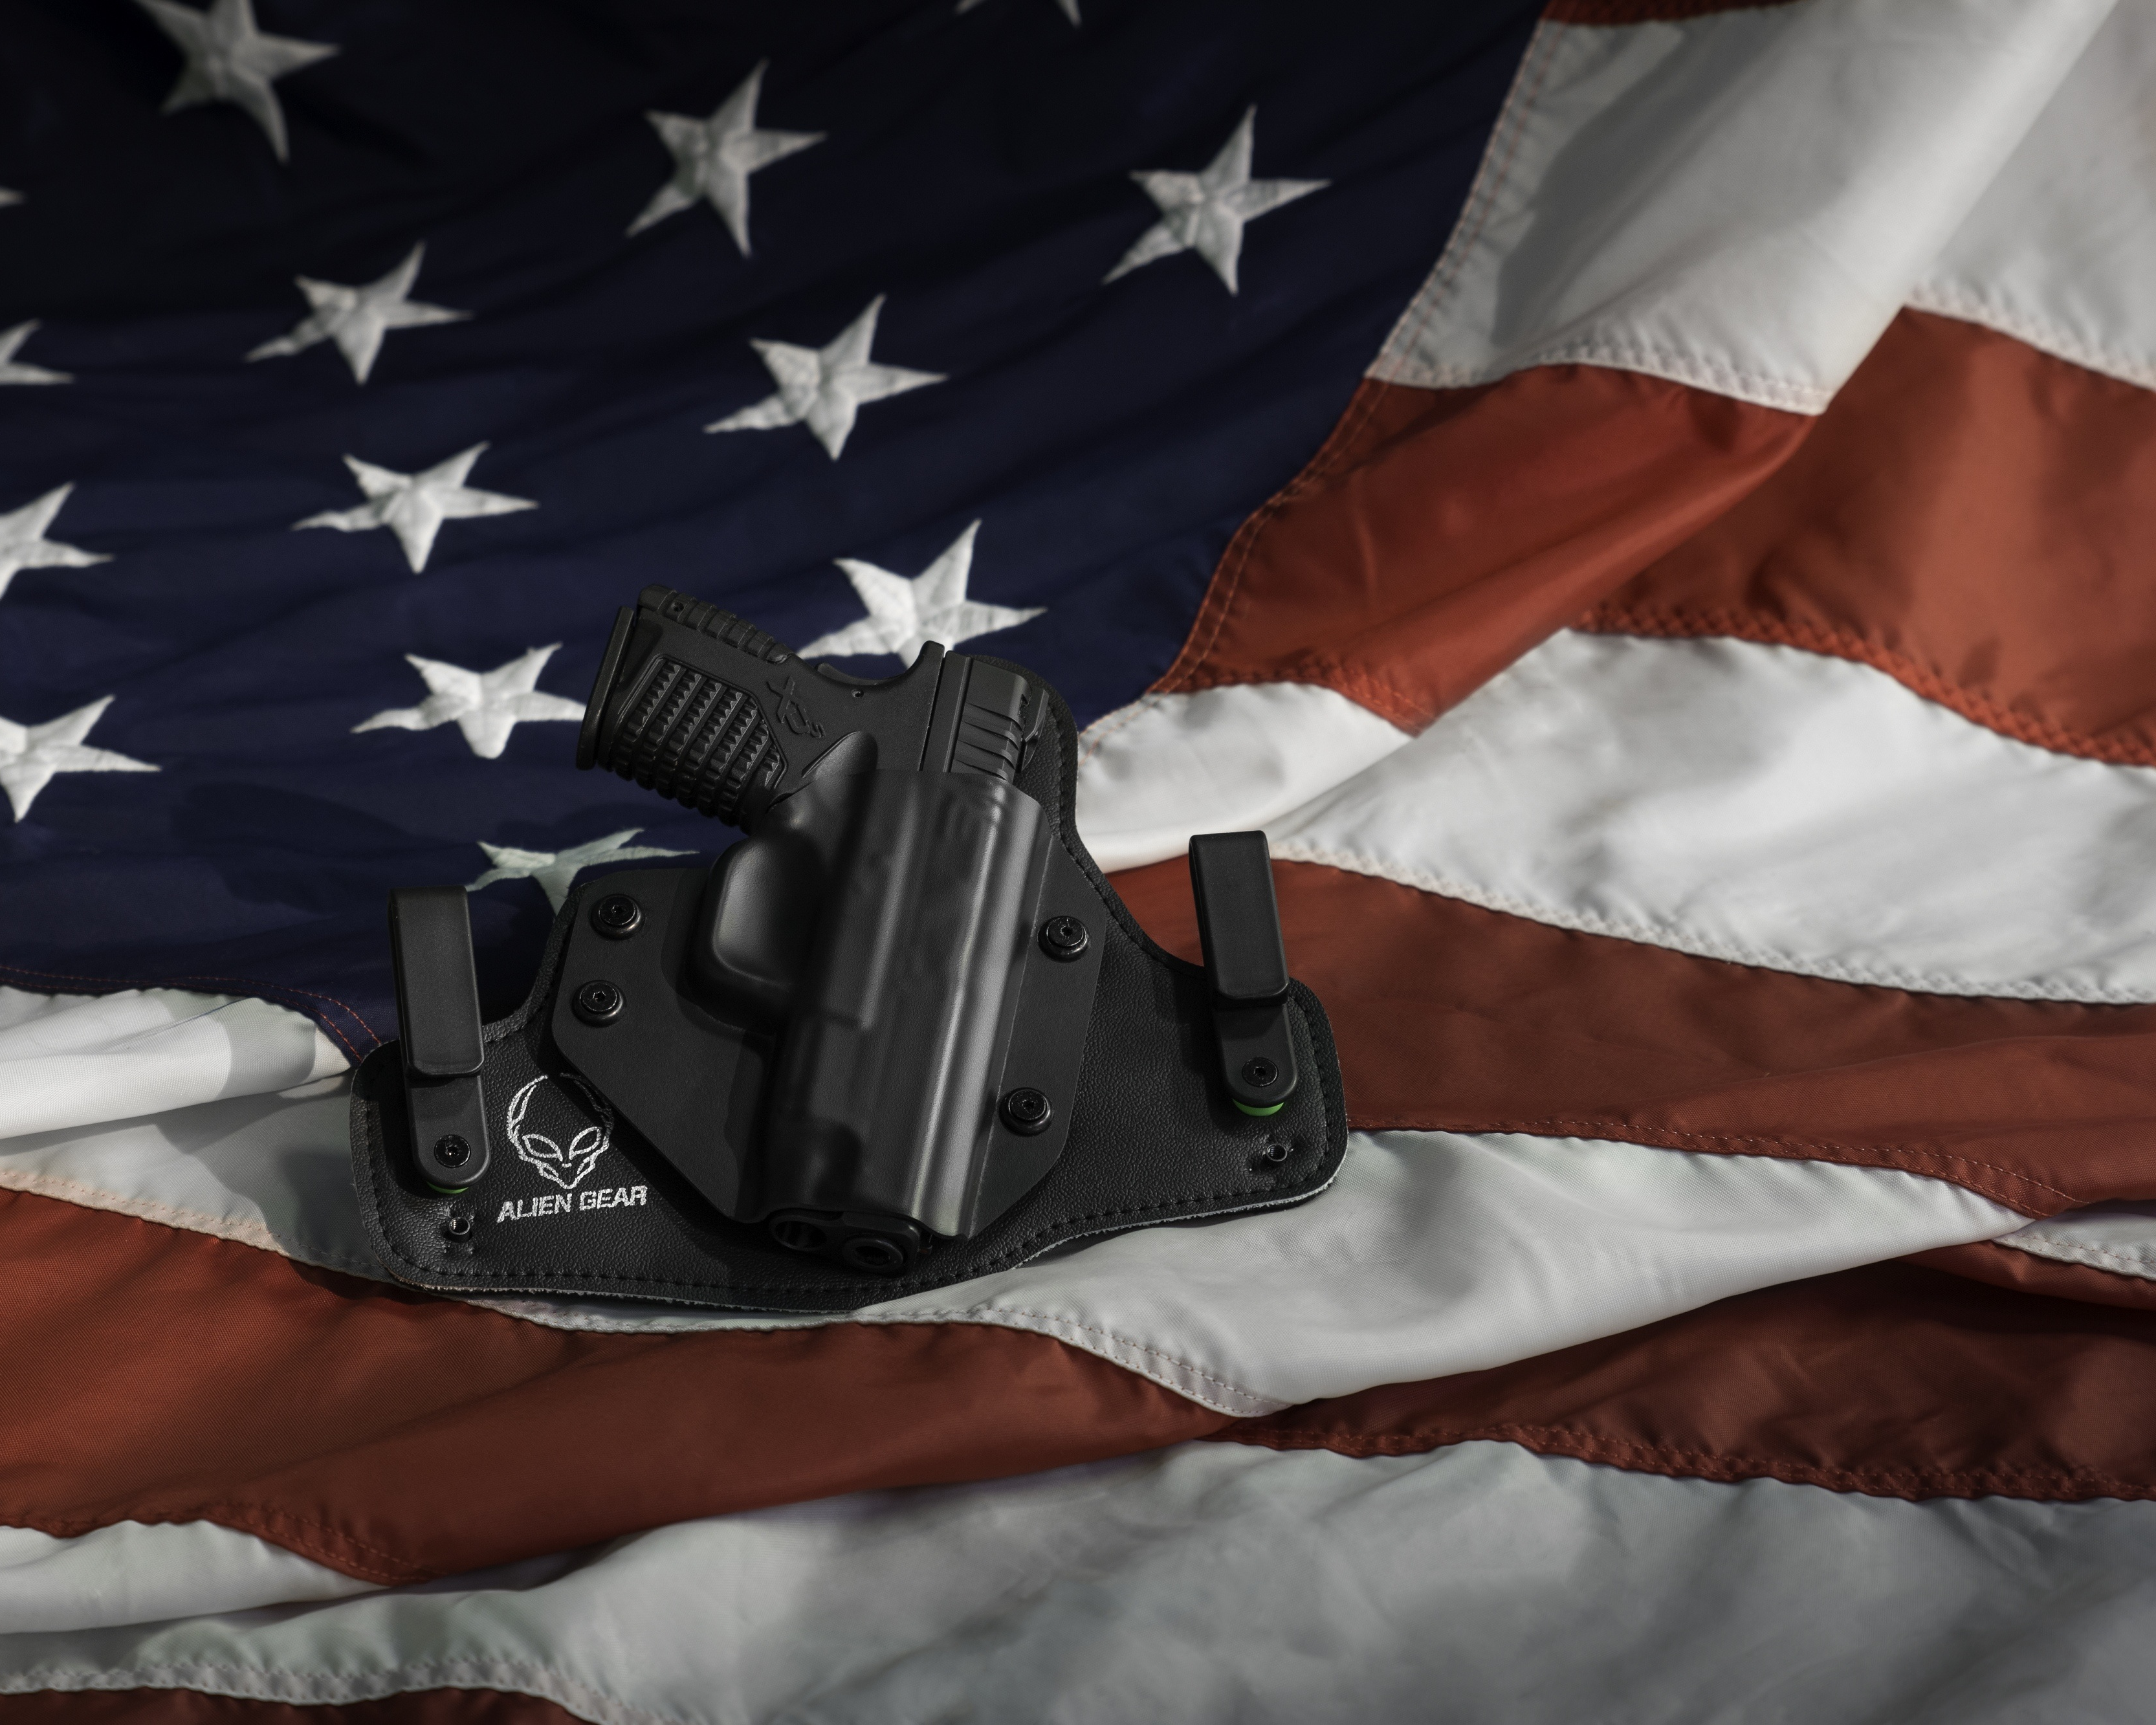
Project Overview
In this project, I created a platform/dashboard and three web pages where you can find data related to gun background checks in the USA from the years 2015 to 2022 for each state. I also created visualizations in correlation with factors (such as Median income, firearm deaths, death rate, and race firearm violence) influencing the need for checking.

Slide 4












Diagram

Slide 5


File Sources
GitHub - BuzzFeedNews/nics-firearm-background-checks: Monthly data from the FBI's National Instant Criminal Background Check System, converted from PDF to CSV.
The website we will be scraping from: https://fred.stlouisfed.org/release/tables?rid=249&eid=259515#snid=259516
https://www.kff.org/other/state-indicator/firearms-death-rate-by-raceethnicity/?currentTimeframe=0&sortModel=%7B%22colId%22:%22Location%22,%22sort%22:%22asc%22%7D
https://www.cdc.gov/nchs/pressroom/sosmap/homicide_mortality/homicide.htm
https://worldpopulationreview.com/state-rankings/educational-attainment-by-state

Slide 6


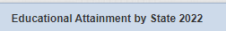





ETL process
Extract
Merging Data
Transform
Load
Convert Data
CSV to JSON
Export

Slide 7

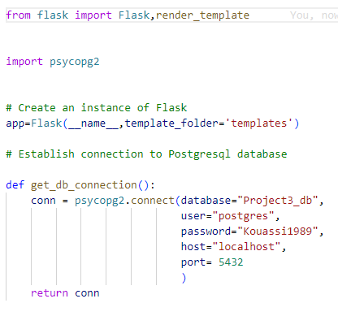
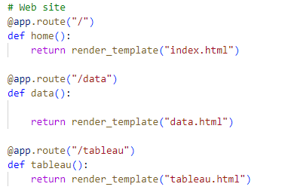
Flask app

Slide 8
JS Libraries
I used leaflet to mark the position of the State with more Gun permit and more firearm violence

Slide 9

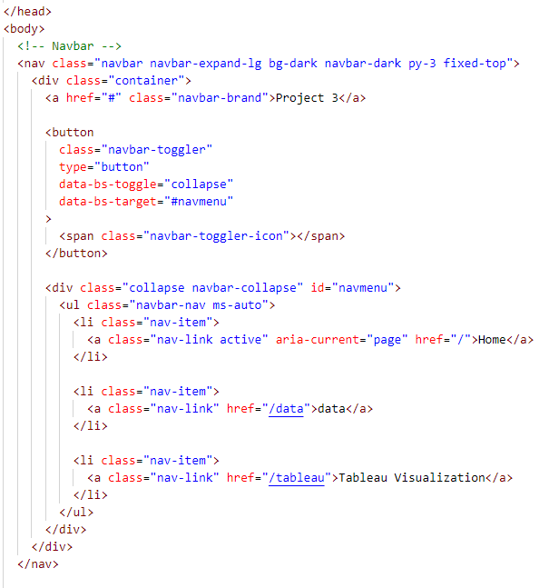
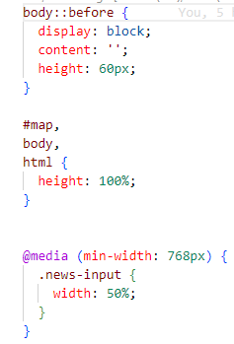
HTML & CSS

Slide 10
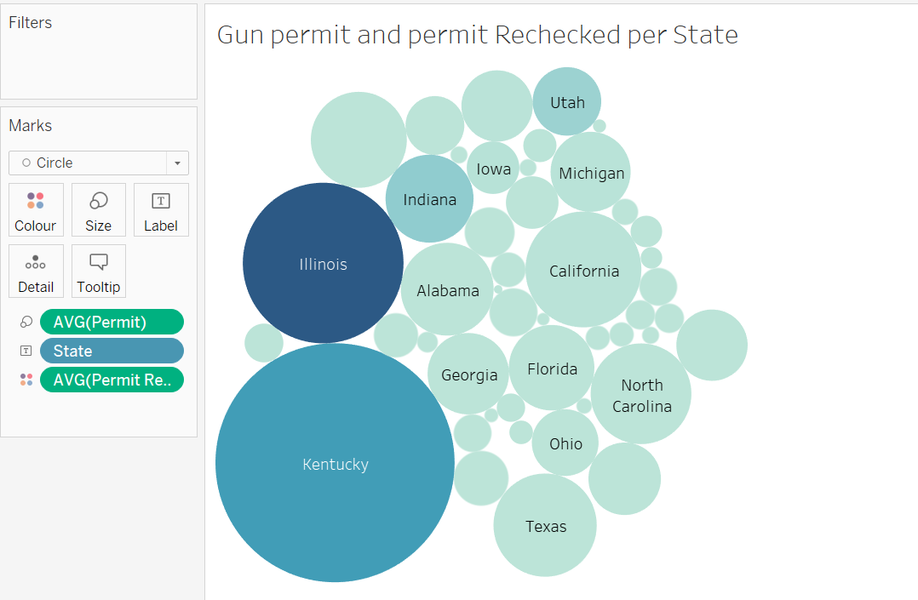
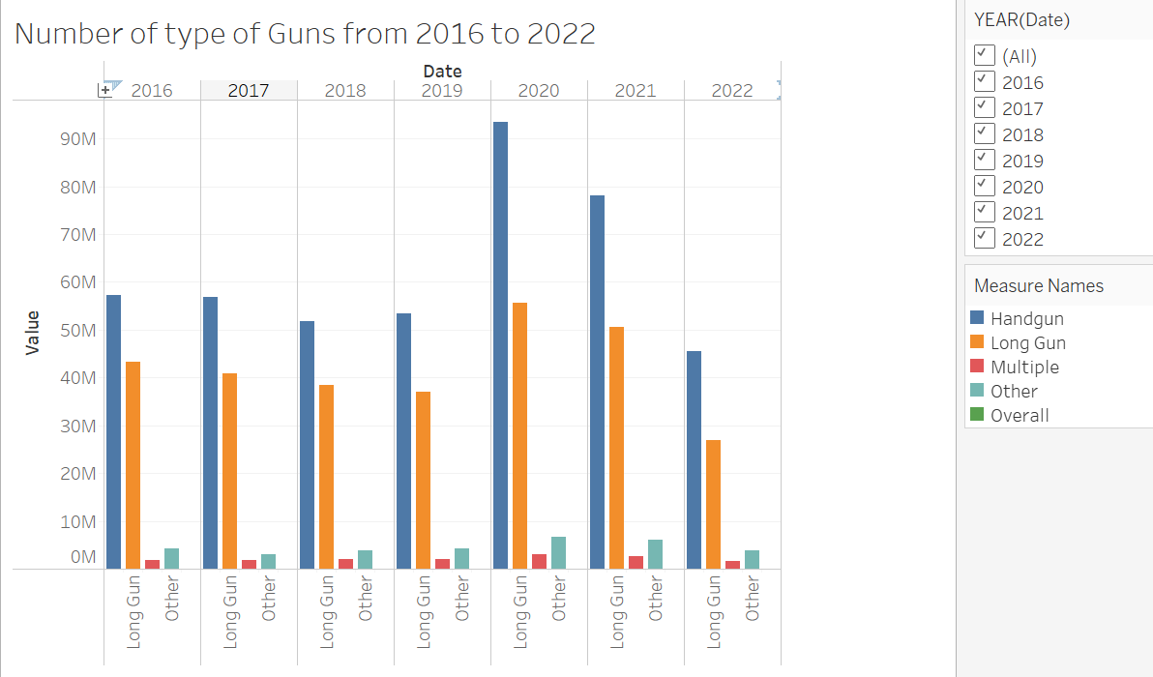
Tableau Visualisation

Slide 11

Inconsistency of the dataset
Re-structuring of the initial idea
PostgreSQL connection issue
Struggle with JavaScript
No expert of web development
Find some professional visualizations with tableau

Slide 12

Website Navigation

Slide 13
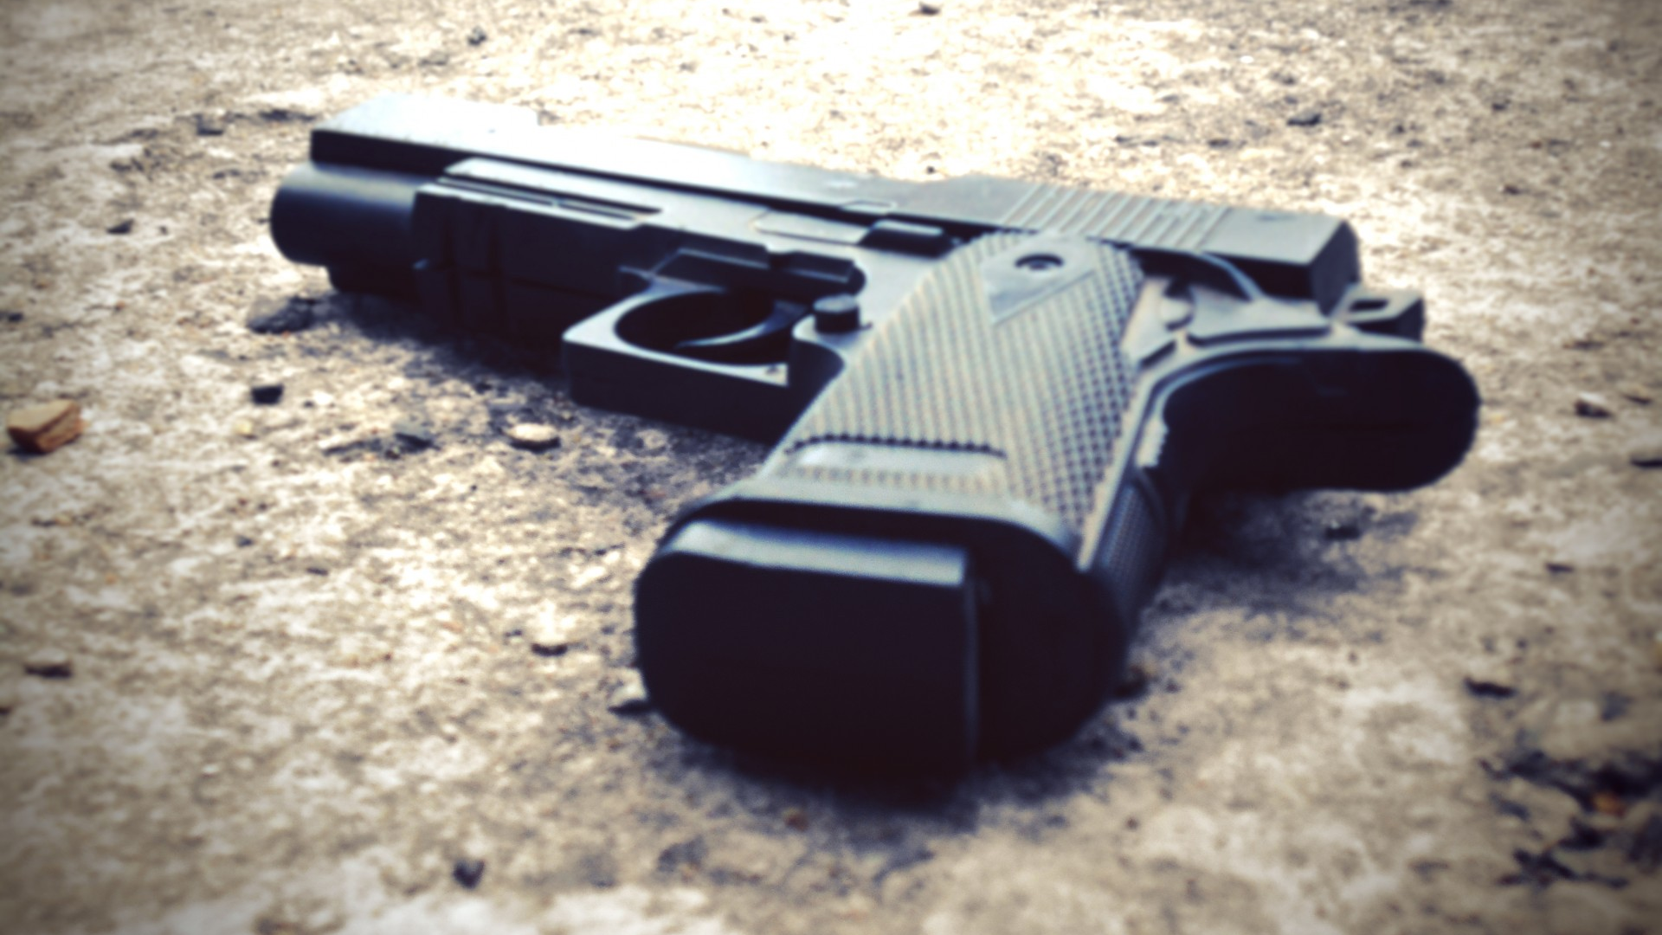
THANK YOU

